Slide 1
Predicting Power Generation Based on Weather Conditions
Enhancing Solar Energy Forecasting with Machine Learning Presented by: Donn Bryan Julian

Slide 2
Problem Statement
Challenge:
Solar power generation fluctuates due to unpredictable weather, leading to inefficiencies in energy production and grid management.
Why it matters:
Accurately predicting solar power generation allows energy providers to optimize production, balance supply with demand, and reduce operational costs. This leads to improved energy efficiency and profitability while contributing to sustainability goals.

Slide 3
Objective
Goal of the Project:
Develop a machine learning model that accurately forecasts solar power generation based on weather conditions, enabling proactive energy management.
Strategic Impact:
This model will support operational efficiency, lower downtime, and optimize the use of renewable energy, helping the company reduce its carbon footprint and improve profitability.

Slide 4
Data Source and Collection
Data Source:
The data comes from Kaggle: Solar Power Generation Data. It includes metrics such as weather data (temperature, irradiation) and solar power generation from multiple plants.
Process:
Data Cleaning: We ensured the data was accurate and consistent.
Feature Engineering: We derived new features like daily temperature averages and cumulative sunlight, ensuring that the model could capture key weather patterns impacting power generation.
Why this matters:
Clean, structured data ensures accurate and reliable model predictions, which directly impact operational decisions.

Slide 5
Key Insights from Data Analysis
Data Insights:
Irradiation (sunlight) is the strongest predictor of solar power generation.
Temperature: Extreme temperatures reduce efficiency, while moderate conditions support optimal energy production.
Why this matters:
By identifying key weather factors, we ensure the model focuses on the most impactful variables, resulting in more accurate predictions that can directly inform decisions like energy storage and grid management.

Slide 6
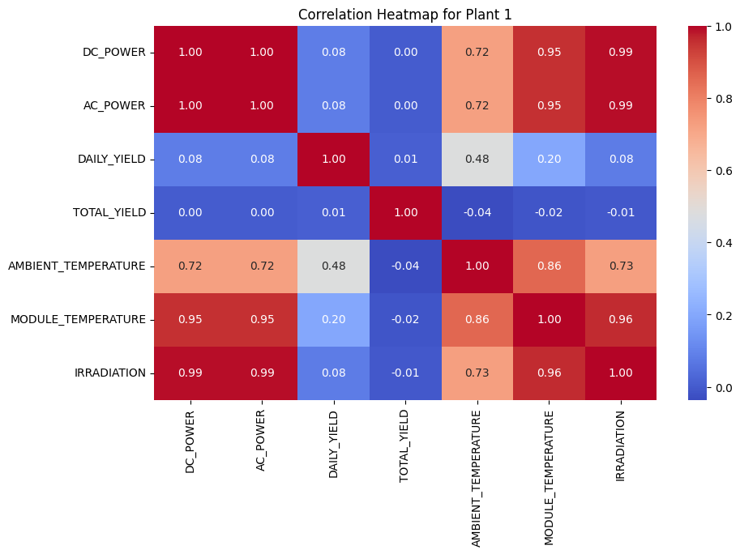
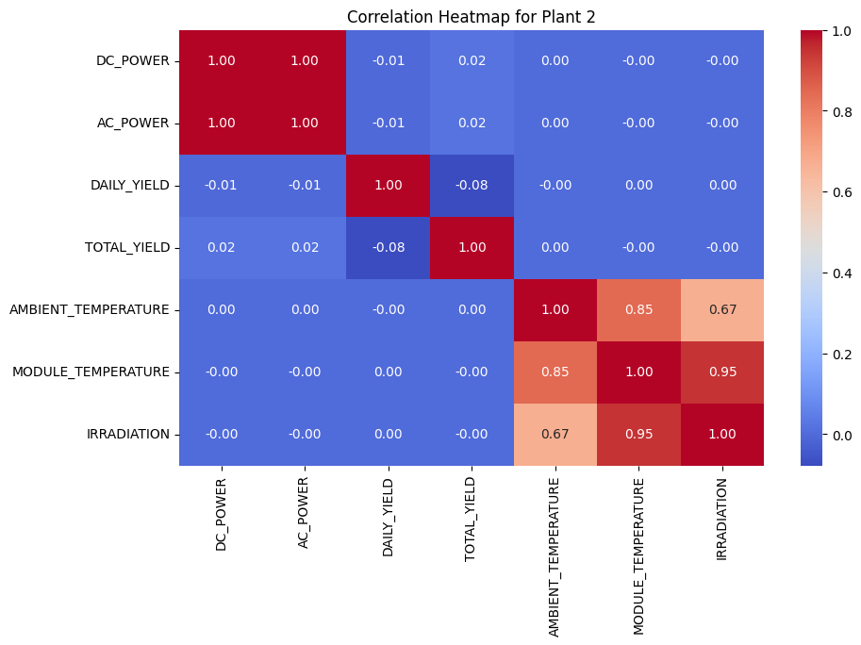
As you can see in these heatmaps, irradiation has the strongest positive correlation with power generation, confirming that sunny days significantly boost solar output. Temperature, while important, shows a more complex relationship, with extreme temperatures lowering efficiency.

Slide 7
Model Comparison and Results
Why test multiple models?
We compared several models to ensure we selected the one with the highest predictive accuracy and operational reliability.
Model Results:
Random Forest:
MSE: 544,483.76
R-squared: 0.9662
Linear Regression:
MSE: 6,106,786.11
R-squared: 0.6212
Gradient Boosting:
MSE: 2,241,848.61
R-squared: 0.8609
Decision Tree:
MSE: 1,007,078.71
R-squared: 0.9375
XGBoost (Final Model):
MSE: 1,143,139.55
R-squared: 0.9291
LightGBM:
MSE: 1,476,544.75
R-squared: 0.9084
SVM:
MSE: 23,405,959.47
R-squared: -0.4518
Why this matters:
XGBoost was chosen for its high performance and efficiency. It provided the most reliable predictions, enabling solar power operators to make informed decisions about energy production and resource allocation.

Slide 8
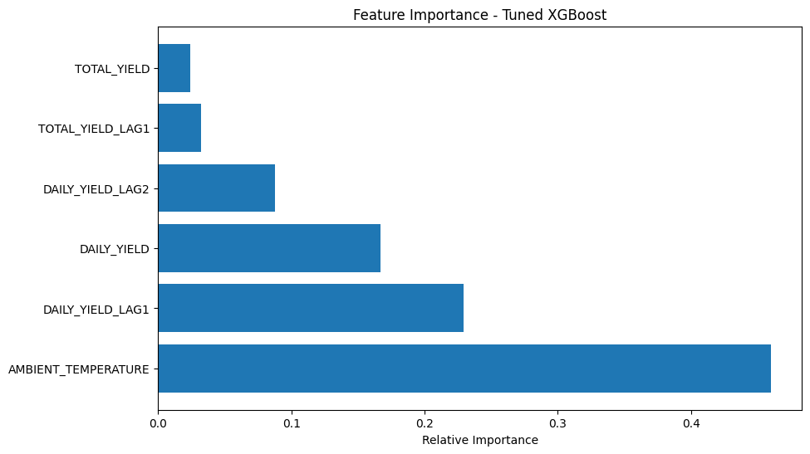
The feature importance plot from XGBoost shows that ambient temperature plays a key role in predicting solar power output, alongside daily yields from previous days. This helps our model prioritize the most relevant data for better accuracy.

Slide 9
Why XGBoost?
Why we chose XGBoost:
High Performance: XGBoost delivered strong R-squared values (0.9291) and relatively low prediction errors (MSE: 1,143,139.55), ensuring accurate energy forecasts.
Handling Complexity: XGBoost is designed to manage non-linear relationships between weather and power output, making it ideal for complex real-world scenarios.
Efficiency: XGBoost provides faster computations and better scalability, allowing operators to respond more quickly to changes in weather patterns and power demands.
Why this matters:
XGBoost ensures operational reliability by providing accurate predictions that help optimize solar power production, reduce downtime, and improve overall energy management.

Slide 10
Model Deployment & Evaluation
Model Deployment Strategy:
The data was split into 80% for training and 20% for testing, ensuring that the model performs well on unseen data and can be used to make real-world predictions.
Evaluation Metrics:
MSE (Mean Squared Error): Measures the accuracy of the model’s predictions.
R-Squared: Indicates how well the model explains the variance in solar power generation based on weather inputs.
Why this matters:
These metrics confirm that XGBoost delivers accurate and reliable predictions, providing operators with the information they need to make timely, informed decisions.

Slide 11
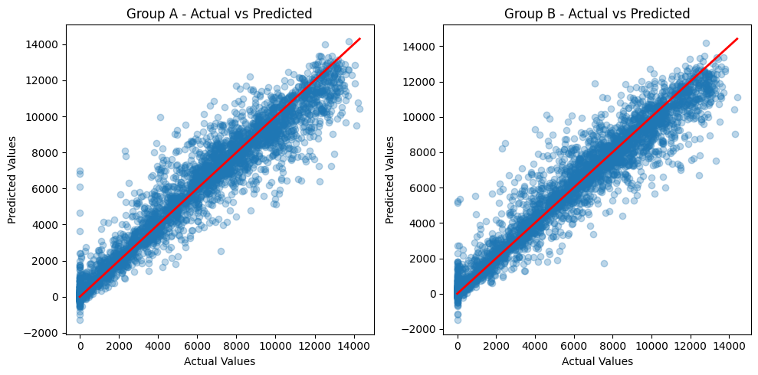
Here we see the predicted versus actual solar power generation values for two test groups. The closer the data points are to the red line, the more accurate the model's predictions. This indicates that our model is performing reliably across different datasets.

Slide 12
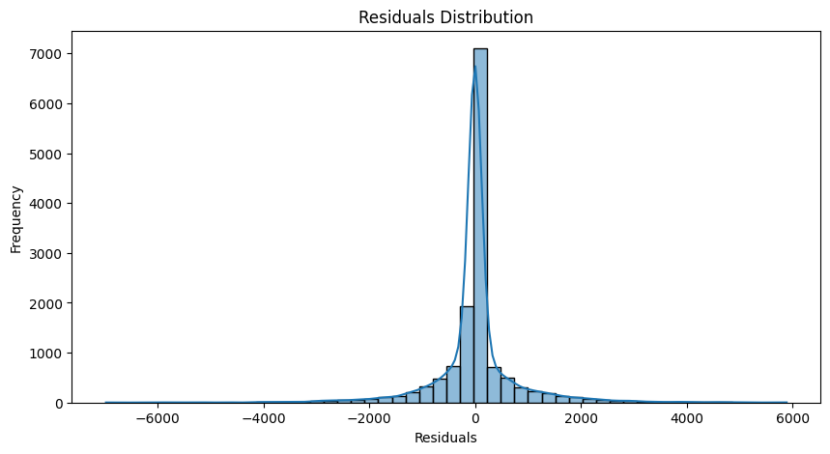
This residuals distribution plot shows that most errors are centered around zero, indicating that the model’s predictions are accurate with minimal bias. The small residuals also suggest that the model performs consistently across different test cases.

Slide 13
Impact on Operations
Operational Benefits:
Optimized Scheduling: The ability to predict low-output days helps optimize maintenance schedules, minimizing disruption during high-generation periods.
Energy Storage Optimization: High-output day forecasts enable energy storage systems to be prepared to capture excess power, improving efficiency.
Grid Management: Accurate forecasts help grid operators balance solar energy with other energy sources, improving overall grid stability and reducing costs.
Why this matters:
This model provides actionable insights that reduce operational waste, optimize energy use, and drive cost savings, contributing to both short- and long-term profitability.

Slide 14
Environmental and Strategic Benefits
Sustainability Impact:
The model enables more efficient use of renewable energy, reducing dependency on fossil fuels and supporting our company’s sustainability and carbon reduction goals.
Strategic Alignment:
Accurate energy forecasting supports our strategic goal of becoming a leader in renewable energy, increasing our competitiveness and positioning us as innovators in the clean energy market.
Why this matters:
This project not only drives operational efficiency but also supports broader corporate goals around environmental sustainability and strategic growth in the renewable energy sector.

Slide 15
Next Steps & Future Improvements
What’s Next?
Refinements: Adding additional weather variables such as cloud cover and wind speed could improve prediction accuracy, providing even more precise forecasts.
Real-time Integration: Incorporating real-time data feeds can enable dynamic forecasting, allowing operators to make immediate adjustments based on changing weather conditions.
Scalability: Deploy this model across multiple solar plants and other renewable energy projects to drive efficiencies on a larger scale.
Why this matters:
Continuous improvements in the model will enhance our ability to optimize solar energy production and reduce costs, making the model more valuable as we expand our renewable energy footprint.

Slide 16
Conclusion
What we achieved:
We successfully developed an XGBoost-powered model that accurately predicts solar power generation based on weather conditions. This model is ready for deployment and is expected to provide significant operational and environmental benefits.
Strategic Takeaway:
This project aligns with our broader strategy of leading in renewable energy, reducing operational costs, improving energy efficiency, and achieving sustainability goals.

Slide 17
Thank You
Questions?

